Slide 1
Chapter 8
Advanced SQL

Slide 2
Learning Objectives
In this chapter, you will learn:
How to use the advanced SQL JOIN operator syntax
About the different types of subqueries and correlated queries
How to use SQL functions to manipulate dates, strings, and other data
About the relational set operators UNION, UNION ALL, INTERSECT, and MINUS

Slide 3
Learning Objectives
In this chapter, you will learn:
How to create and use views and updatable views
How to create and use triggers and stored procedures
How to create embedded SQL

Slide 4
SQL Join Operators
Relational join operation merges rows from two tables and returns rows with one of the following:
Natural join - common values in common columns
Equality or inequality - meet a given join condition
Outer join – common values in common columns or no matching values
Inner join: Rows that meet a given criterion are selected
Equality condition (natural join or equijoin) or inequality condition (theta join)
Outer join: Returns matching rows and rows with unmatched attribute values for one or both joined tables

Slide 5
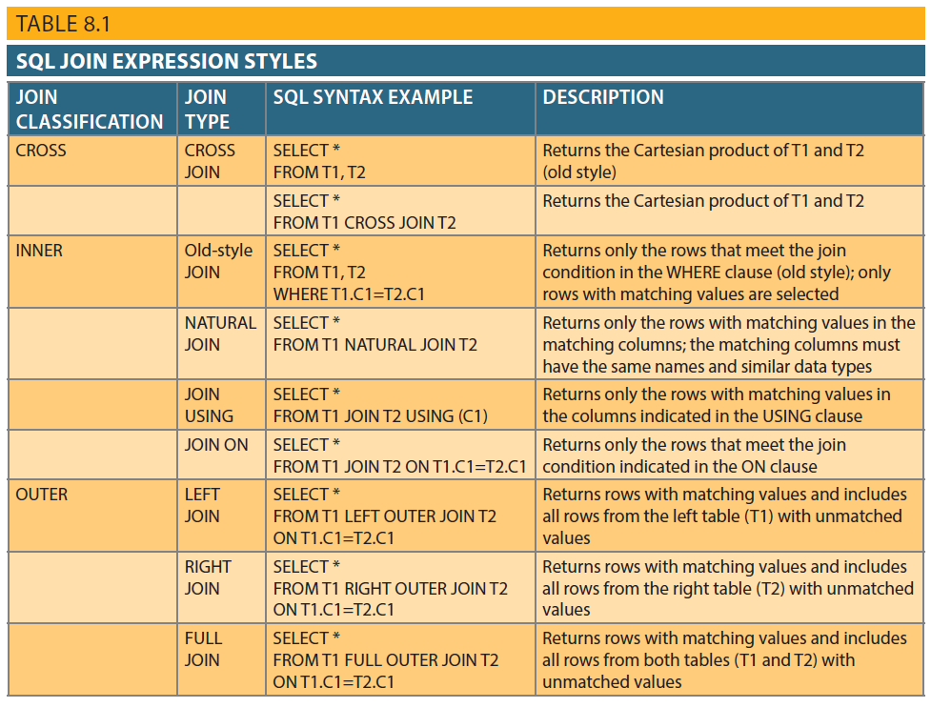
Table 8.1 - SQL Join Expression Styles

Slide 6
Subqueries and Correlated Queries
Subquery is a query inside another query
Subquery can return:
One single value - One column and one row
A list of values - One column and multiple rows
A virtual table - Multicolumn, multirow set of values
No value - Output of the outer query might result in an error or a null empty set

Slide 7
WHERE Subqueries
Uses inner SELECT subquery on the right side of a WHERE comparison expression
Value generated by the subquery must be of a comparable data type
If the query returns more than a single value, the DBMS will generate an error
Can be used in combination with joins

Slide 8
IN and HAVING Subqueries
IN subqueries
Used to compare a single attribute to a list of values
HAVING subqueries
HAVING clause restricts the output of a GROUP BY query by applying conditional criteria to the grouped rows

Slide 9
Multirow Subquery Operators: ANY and ALL
ALL operator
Allows comparison of a single value with a list of values returned by the first subquery
Uses a comparison operator other than equals
ANY operator
Allows comparison of a single value to a list of values and selects only the rows for which the value is greater than or less than any value in the list

Slide 10
FROM and Attribute List Subqueries
FROM clause:
Specifies the tables from which the data will be drawn
Can use SELECT subquery
SELECT statement uses attribute list to indicate what columns to project in the resulting set
Inline subquery
Subquery expression included in the attribute list that must return one value
Column alias cannot be used in attribute list computation if alias is defined in the same attribute list

Slide 11
Correlated Subqueries
Executes once for each row in the outer query
Inner query references a column of the outer subquery
Can be used with the EXISTS special operator

Slide 12
SQL Functions
Functions always use a numerical, date, or string value
Value may be part of a command or may be an attribute located in a table
Function may appear anywhere in an SQL statement where a value or an attribute can be used

Slide 13
SQL Functions
Date and time functions
Numeric functions
String functions
Conversion functions

Slide 14
Relational Set Operators
SQL data manipulation commands are set-oriented
Set-oriented: Operate over entire sets of rows and columns at once
UNION, INTERSECT, and Except (MINUS) work properly when relations are union-compatible
Union-compatible: Number of attributes are the same and their corresponding data types are alike
UNION
Combines rows from two or more queries without including duplicate rows

Slide 15
Relational Set Operators
Syntax - query UNION query
UNION ALL
Produces a relation that retains duplicate rows
Can be used to unite more than two queries
INTERSECT
Combines rows from two queries, returning only the rows that appear in both sets
Syntax - query INTERSECT query

Slide 16
Relational Set Operators
EXCEPT (MINUS)
Combines rows from two queries and returns only the rows that appear in the first set
Syntax
query EXCEPT query
query MINUS query
Syntax alternatives
IN and NOT IN subqueries can be used in place of INTERSECT

Slide 17
Virtual Tables: Creating a View
View: Virtual table based on a SELECT query
Base tables: Tables on which the view is based
CREATE VIEW statement: Data definition command that stores the subquery specification in the data dictionary
CREATE VIEW command
CREATE VIEW viewname AS SELECT query

Slide 18
Updatable Views
Used to update attributes in any base tables used in the view
Batch update routine: Pools multiple transactions into a single batch to update a master table field in a single operation
Updatable view restrictions
GROUP BY expressions or aggregate functions cannot be used
Set operators cannot be used
JOINs or group operators cannot be used

Slide 19
Oracle Sequences
Independent object in the database
Have a name and can be used anywhere a value expected
Not tied to a table or column
Generate a numeric value that can be assigned to any column in any table
Table attribute with an assigned value can be edited and modified

Slide 20
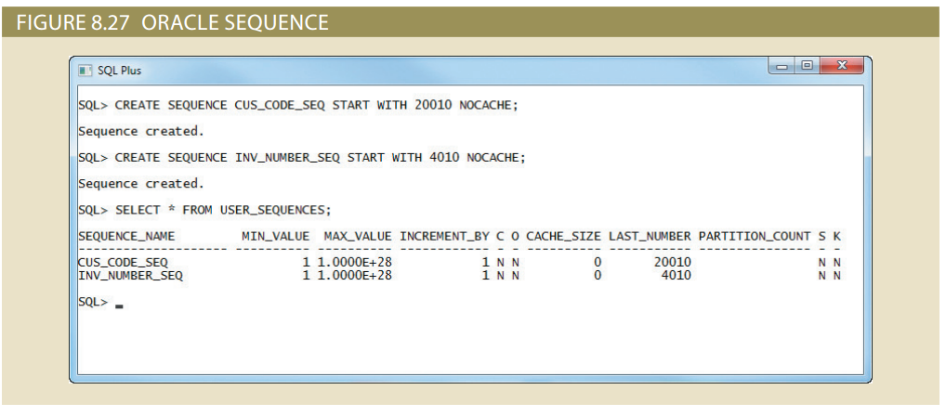
Figure 8.27 - Oracle Sequence

Slide 21
Procedural SQL
Performs a conditional or looping operation by isolating critical code and making all application programs call the shared code
Yields better maintenance and logic control
Persistent stored module (PSM): Block of code containing:
Standard SQL statements
Procedural extensions that is stored and executed at the DBMS server

Slide 22
Procedural SQL
Procedural Language SQL (PL/SQL)
Use and storage of procedural code and SQL statements within the database
Merging of SQL and traditional programming constructs
Procedural code is executed as a unit by DBMS when invoked by end user
End users can use PL/SQL to create:
Anonymous PL/SQL blocks and triggers
Stored procedures and PL/SQL functions

Slide 23
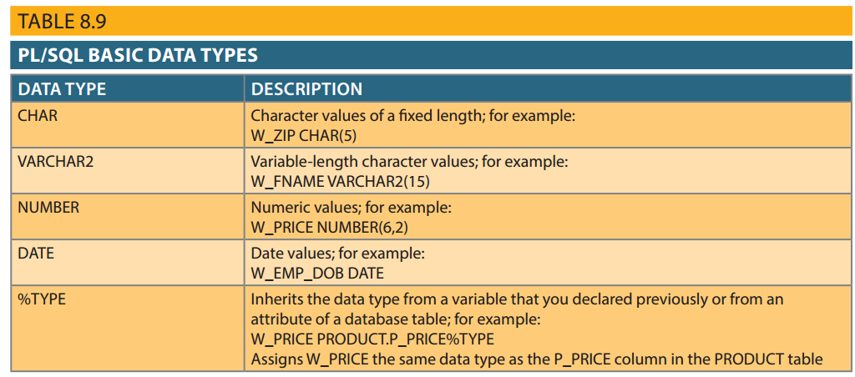
Table 8.9 - PL/SQL Basic Data Types

Slide 24
Triggers
Procedural SQL code automatically invoked by RDBMS when given data manipulation event occurs
Parts of a trigger definition
Triggering timing - Indicates when trigger’s PL/SQL code executes
Triggering event - Statement that causes the trigger to execute
Triggering level - Statement- and row-level
Triggering action - PL/SQL code enclosed between the BEGIN and END keywords

Slide 25
Triggers
DROP TRIGGER trigger_name command
Deletes a trigger without deleting the table
Trigger action based on DML predicates
Actions depend on the type of DML statement that fires the trigger

Slide 26
Stored Procedures
Named collection of procedural and SQL statements
Advantages
Reduce network traffic and increase performance
Reduce code duplication by means of code isolation and code sharing

Slide 27
PL/SQL Processing with Cursors
Cursor: Special construct used to hold data rows returned by a SQL query
Implicit cursor: Automatically created when SQL statement returns only one value
Explicit cursor: Holds the output of a SQL statement that may return two or more rows
Cursor-style processing involves retrieving data from the cursor one row at a time
Current row is copied to PL/SQL variables

Slide 28
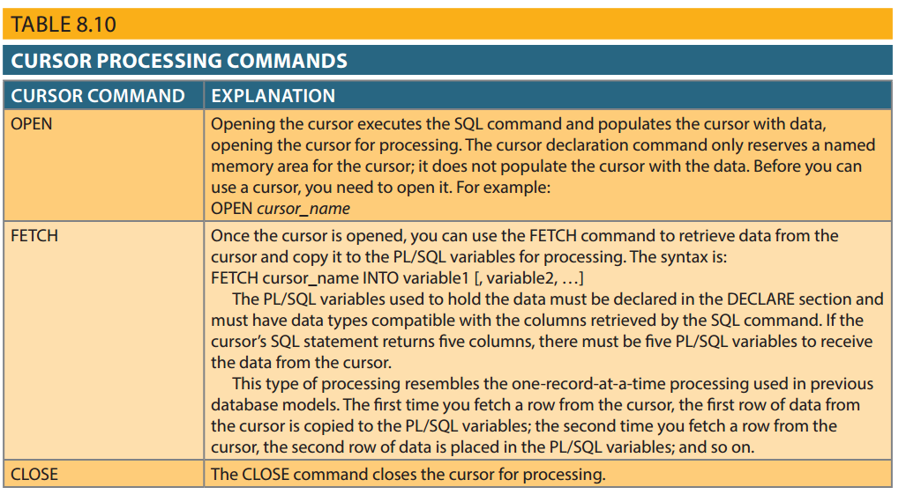
Table 8.10 - Cursor Processing Commands

Slide 29
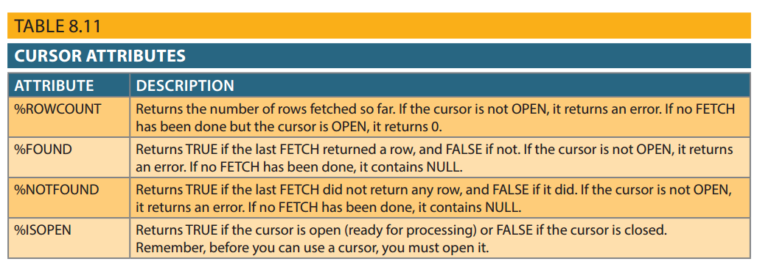
Table 8.11 - Cursor Attributes

Slide 30
PL/SQL Stored Functions
Stored function: Named group of procedural and SQL statements that returns a value
As indicated by a RETURN statement in its program code
Can be invoked only from within stored procedures or triggers

Slide 31
Embedded SQL
SQL statements contained within an application programming language
Host language: Any language that contains embedded SQL statements
Differences between SQL and procedural languages
Run-time mismatch
SQL is executed one instruction at a time
Host language runs at client side in its own memory space

Slide 32
Embedded SQL
Processing mismatch
Conventional programming languages process one data element at a time
Newer programming environments manipulate data sets in a cohesive manner
Data type mismatch
Data types provided by SQL might not match data types used in different host languages

Slide 33
Embedded SQL
Embedded SQL framework defines:
Standard syntax to identify embedded SQL code within the host language
Standard syntax to identify host variables
Communication area used to exchange status and error information between SQL and host language

Slide 34
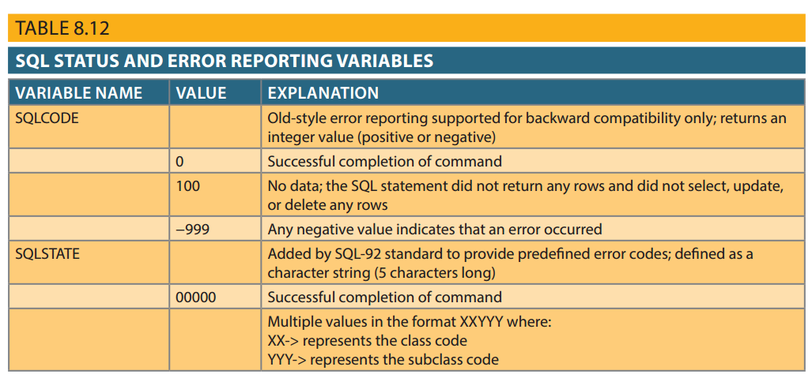
Table 8.12 - SQL Status and Error Reporting Variables

Slide 35
Embedded SQL
Static SQL: Programmer uses predefined SQL statements and parameters
SQL statements will not change while application is running
Dynamic SQL: SQL statement is generated at run time
Attribute list and condition are not known until end user specifies them
Slower than static SQL
Requires more computer resources

